Slide 1
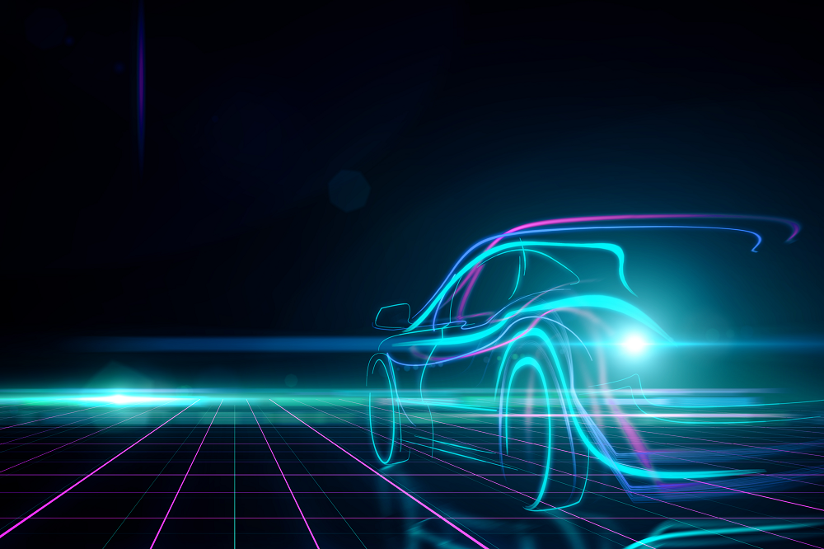
Human Computer Interaction (HMI) in Autonomous Vehicles

Slide 2
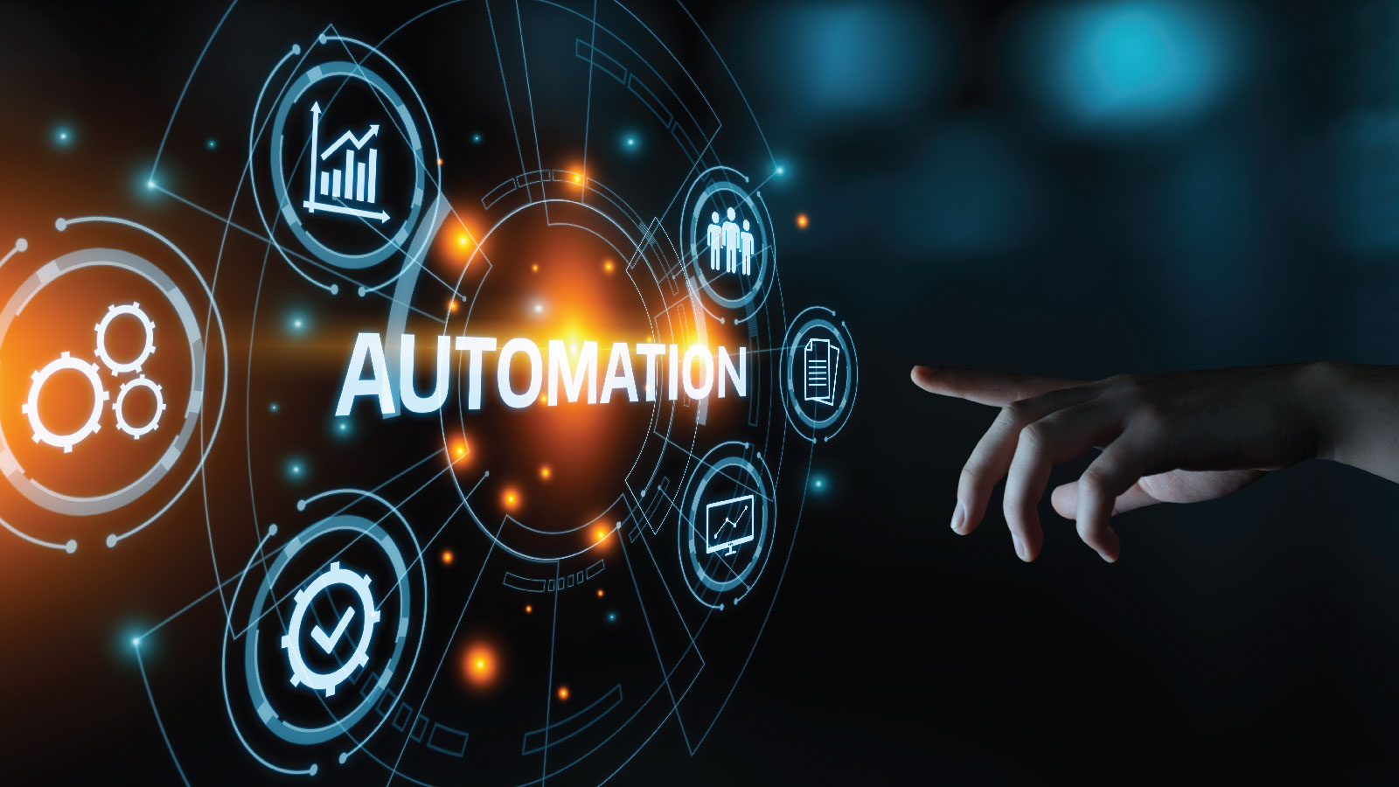
Domain: Computer Vision, Human Computer Interaction.

Slide 3

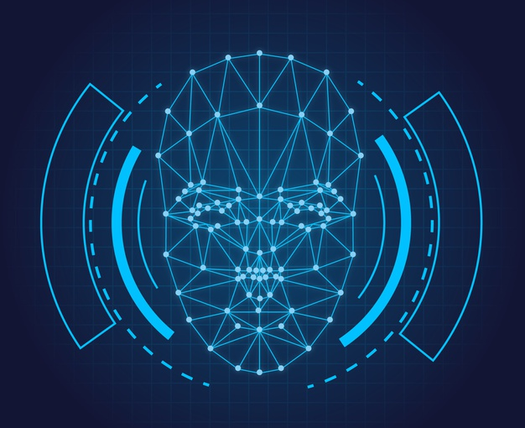
Done under the guidance of -Dr. Archana Ghotkar
BY-
Harshal Hiwale (41124)
Sarah Abbas Gazge (41161)
Sreya Patranabish (41169)
Sushmita Shirude (41171)

Slide 4
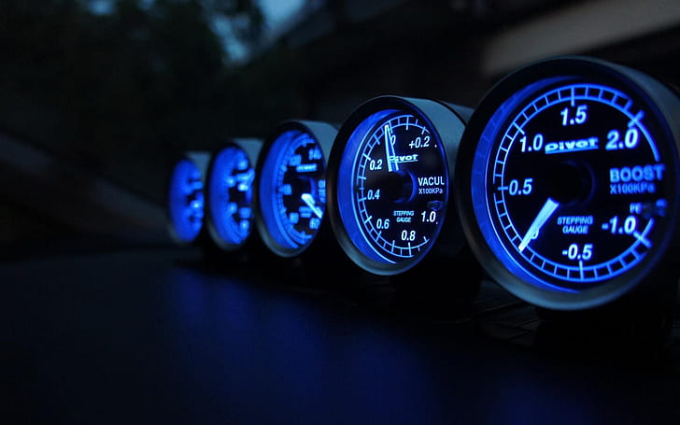
INDEX
Introduction
Motivation
Problem Definition
Objective
Literature Survey
Workflow
Results
Future Scope
References
Conclusion

Slide 5
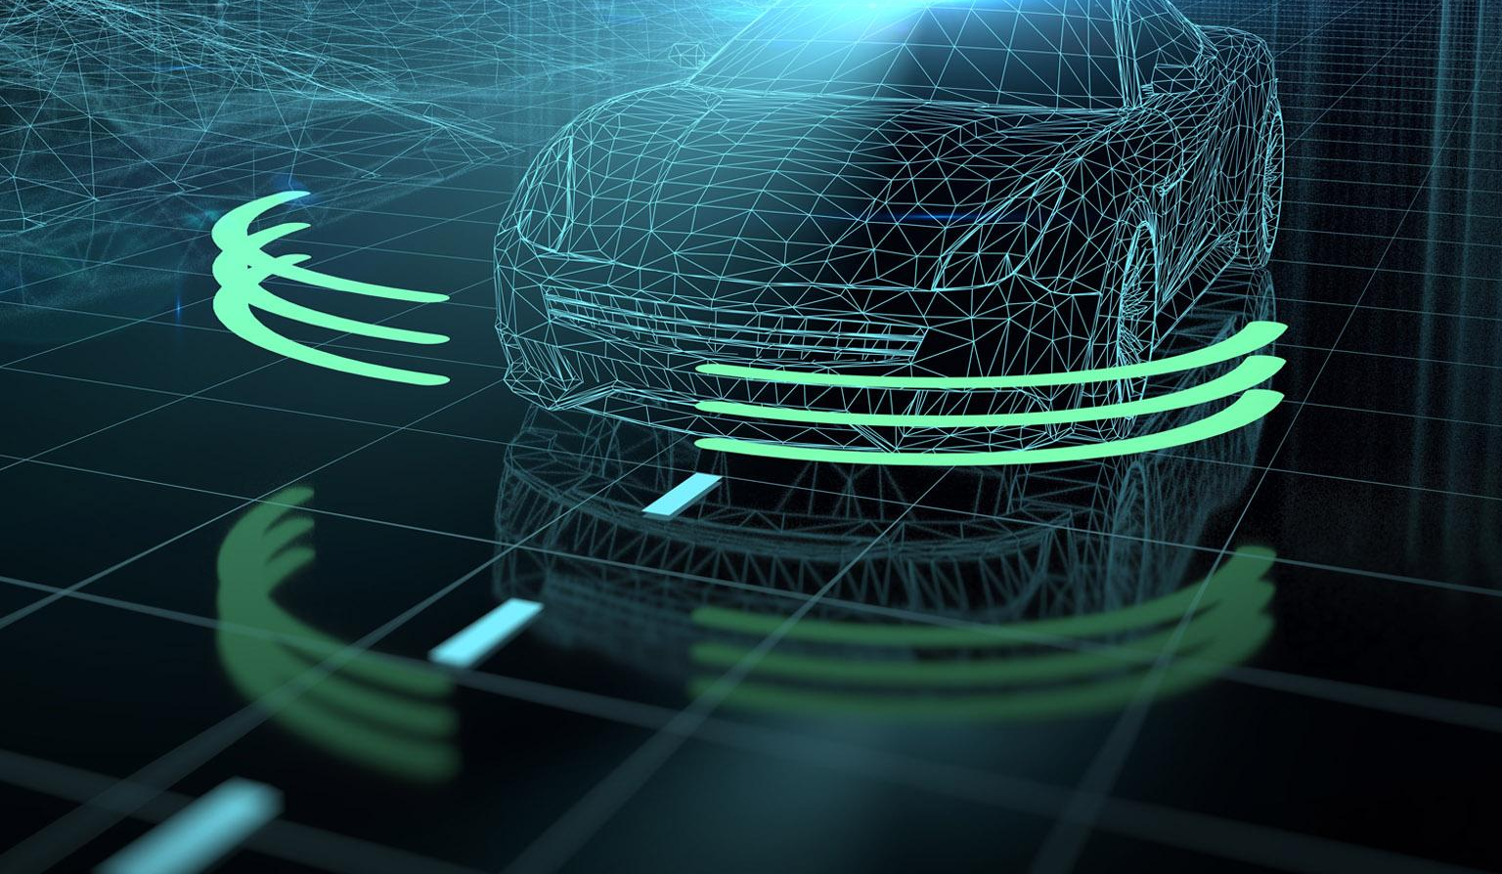
INTRODUCTION
This problem statement presents the need for alerting the driver during overtaking and lane-changing to avoid accidents and disastrous outcomes and to build trust in autonomous systems. The model uses image processing for lane detection and identification of obstacles, vehicles and lane tracking. It calculates the relative velocity during overtaking and the system will share the scenarios with the driver, using an alert system.

Slide 6
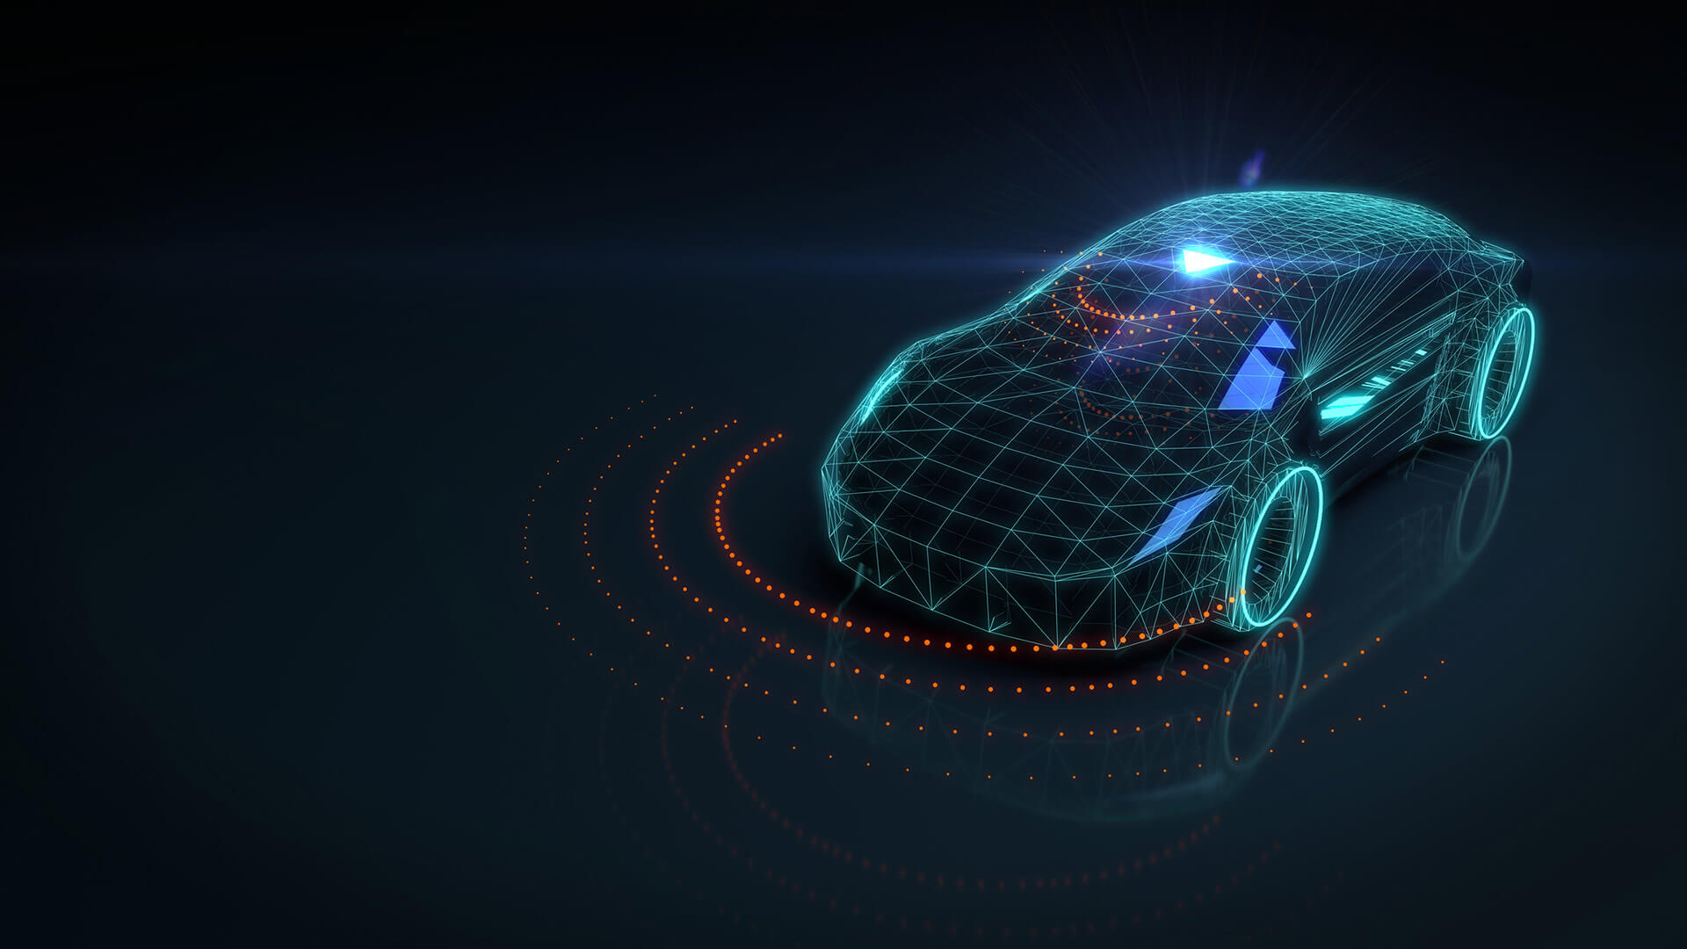
MOTIVATION
Today, and possibly for a long time in the near future, the complete driving task is too complex an activity to be fully formalized as a sensing-acting robotics system that can be explicitly solved using model-based and learning-based approaches in order to achieve fully unconstrained vehicle autonomy.
This is especially true for unconstrained, real-time operation where the permissible range of error is extremely small and the number of limiting-cases is extremely large.
Until these problems are solved, human beings will remain as an inevitable part of the driving task, monitoring the AI system as it performs anywhere from 0 to just under 100 percent of the driving.

Slide 7
Over taking and lane-changing is a critical part in vehicle automation. It is not only an upgrade in technology aspect but it is also an upgrade in social aspect, as differently abled will also be able to have their own vehicle.
Although automation in automobiles has decreased human effort during driving, decreased environmental issues, it is still difficult for people to trust the system. This model targets to bridge the gap between current vehicle technology and autonomous vehicles.

Slide 8
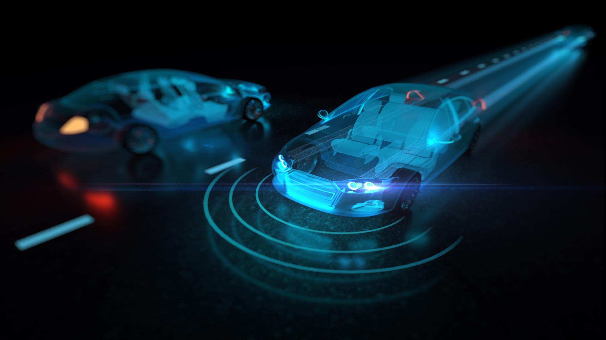
PROBLEM DEFINITION
To design an Alert System in Autonomous Vehicles during lane-changing and overtaking using the concepts of Computer Vision and Human Computer Interaction.

Slide 9
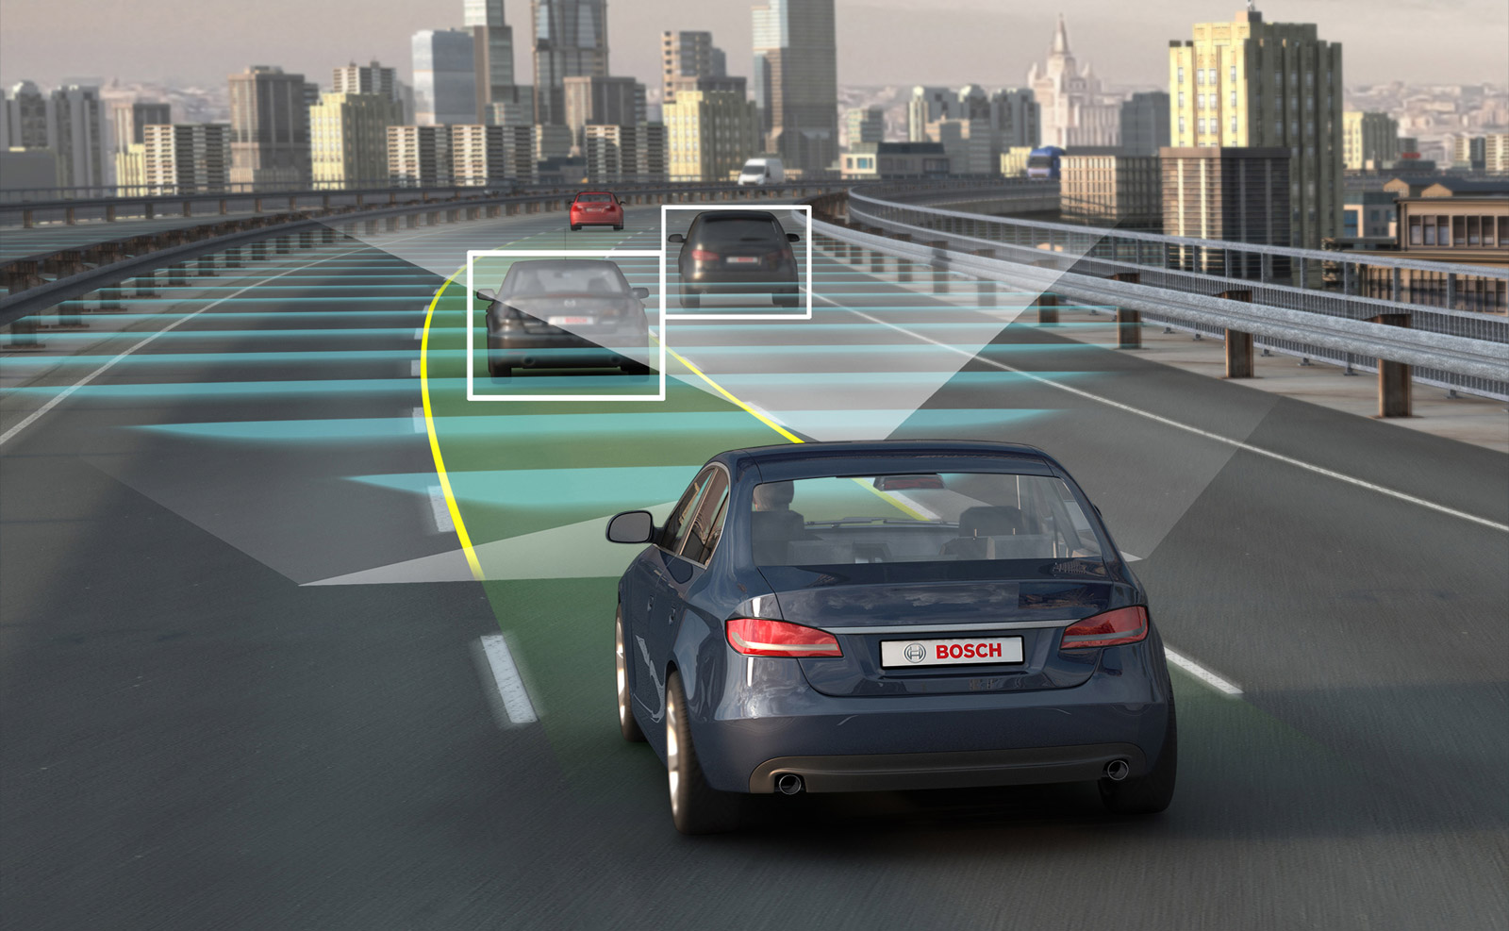
Objective
The main Objective of our project is that the Object is to be able to detect lane change and overtaking .It also assists during the same .

Slide 10

LITERATURE SURVEY
No. | Techniques | Features Extracted | Dataset
1 | YOLO(You Only Look Once) | Detects Microsoft common objects around the vehicle | COCO Dataset
2 | A Cooperative Overtaking Assistance System | the navigation system continuously calculates the vehicle’s pose and kinematics in order to detect a change of lane | own data set
3 | Human Computer Interaction (HMI) in autonomous vehicles for alerting driver during overtaking and lane changing. | Alert system during lane changing and overtaking. | own data set
4 | Large-Scale Naturalistic Driving Study of Driver Behavior and Interaction with Automation | Study about user interaction with autonomous vehicle | DARPA Urban Challenge professional drivers controlling the 30 cars on the road that day.

Slide 11
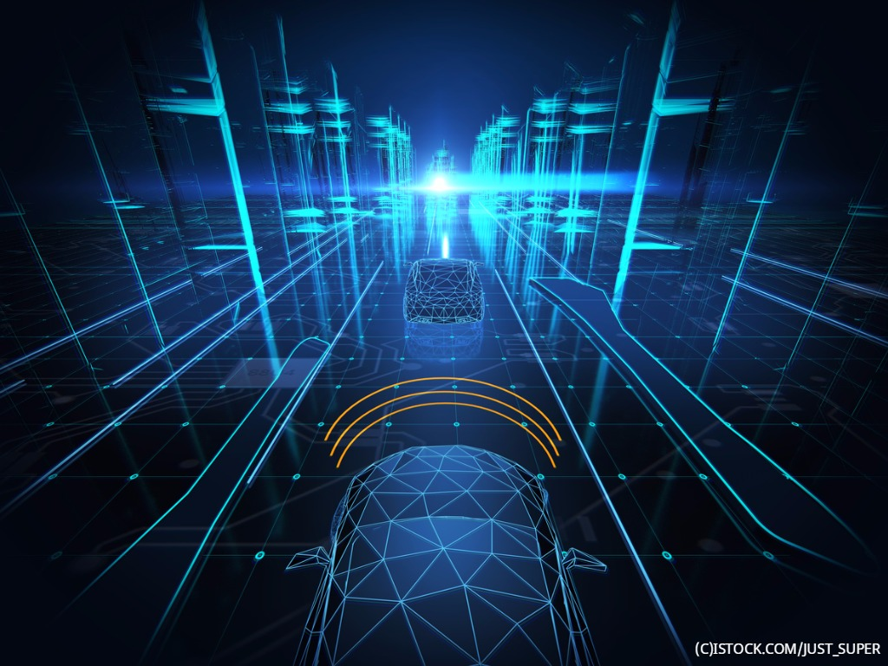
Lane Change Behavior on Multi-lane Freeways

Slide 12
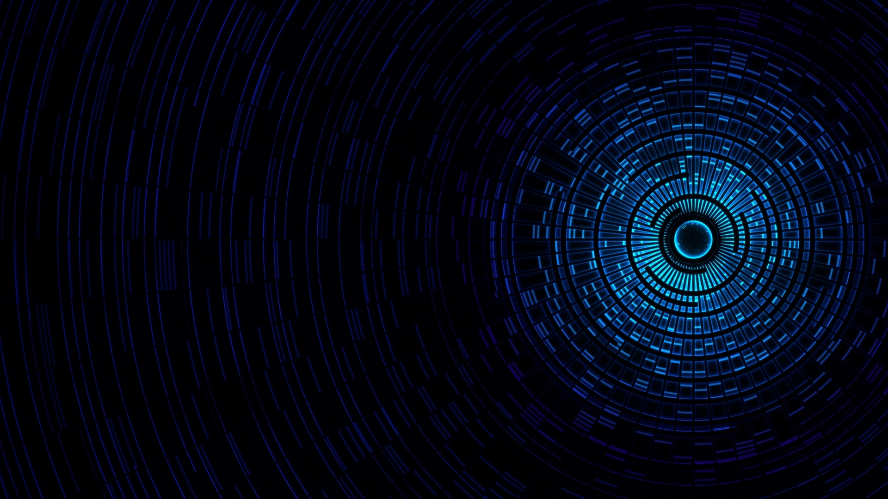
Particularly, it has been found that people drive on the freeway according to the following four strategies:
Strategy 1(speed leading) : Drivers choose a suitable speed for driving on a freeway stretch and try to stick to that speed as much as possible. If required, they change lanes and over take to continue driving at their speed. Also during the overtaking maneuver, they try to stick to their desired speed.
Strategy 2(speed leading with speed increase at overtaking) : As in the previous strategy, drivers choose a suitable speed and try to maintain that speed as much as possible. They may change the lane to overtake a slower driver. Unlike the speed leading strategy, the drivers increase speed during the overtaking and do not stick to the original desired speed.

Slide 13
Strategy 3(lane leading) : Drivers choose a specific lane and adjust their speed to the speed of that lane, but within allowed margins.
Strategy 4(traffic leading) : Drivers have neither a specific lane nor a suitable speed in mind and “go with the flow”.
The highest traffic stability has been observed under speed leading and speed leading with overtaking strategies.

Slide 14


Slide 15
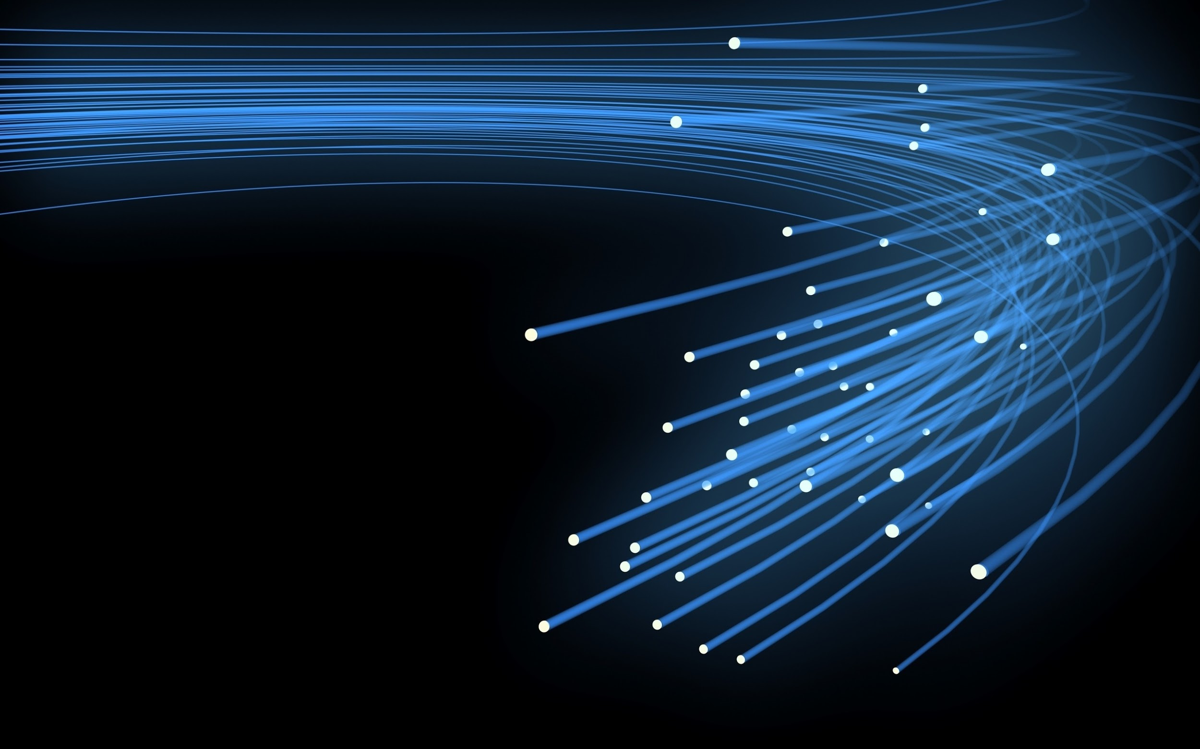
Humans glance at an image and instantly know what objects are in the image, where they are, and how they interact. The human visual system is fast and accurate, allowing us to perform complex tasks like driving with little conscious thought. Fast, accurate algorithms for object detection would allow computers to drive cars without specialized sensors, enable assistive devices to convey real-time scene information to human users, and unlock the potential for general purpose, responsive robotic systems.

Slide 16
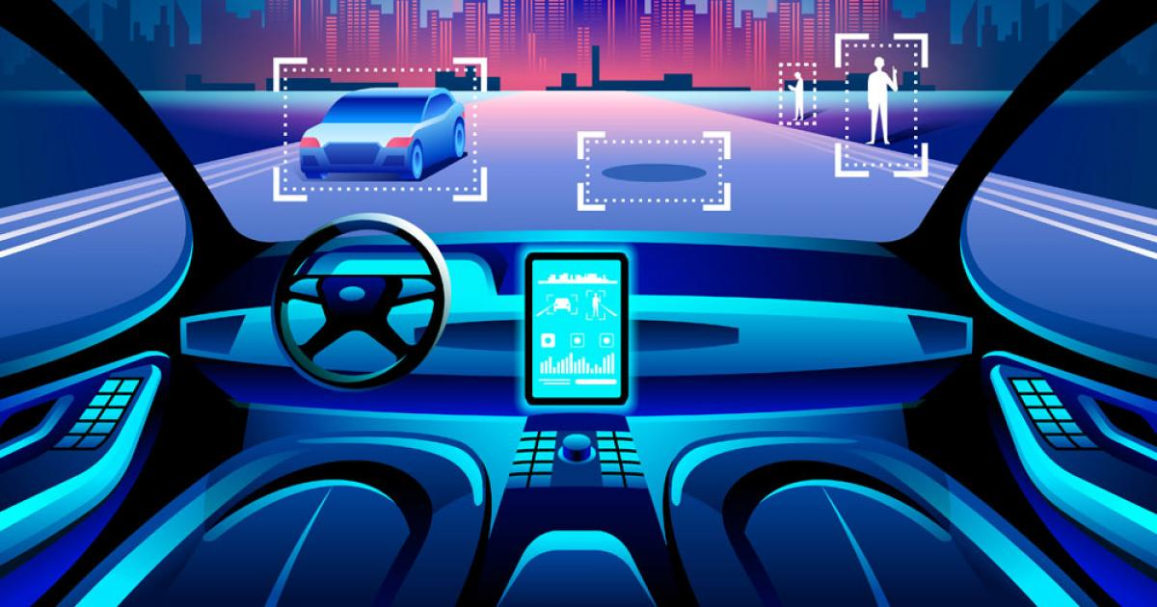
It is an object detection system targeted for real time system. YOLO predicts boundary boxes and each box has confidence score. To make final prediction, we keep those boxes with high confidence scores (>0.25) as our final prediction.

Slide 17
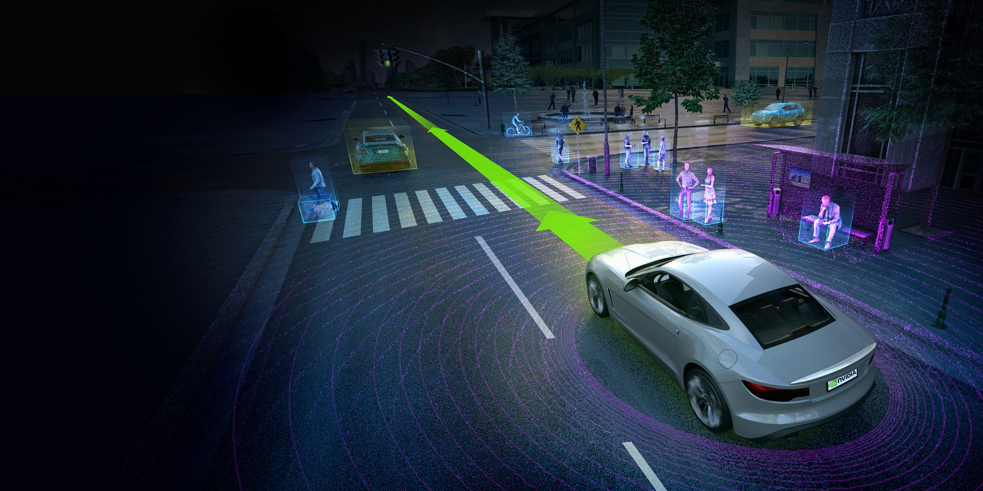
YOLO
* This architecture takes an image as input and resizes it to 448*448 by keeping the aspect ratio same and performing padding.
* This image is then passed in the CNN network. This model has 24 convolution layers, 4 max-pooling layers followed by 2 fully connected layers.
* For the reduction of the number of layers (Channels), we use 1*1 convolution that is followed by 3*3 convolution.
* Notice that the last layer of YOLOv1 predicts a cuboidal output.
* This is done by generating (1, 1470) from final fully connected layer and reshaping it to size (7, 7, 30).

Slide 18
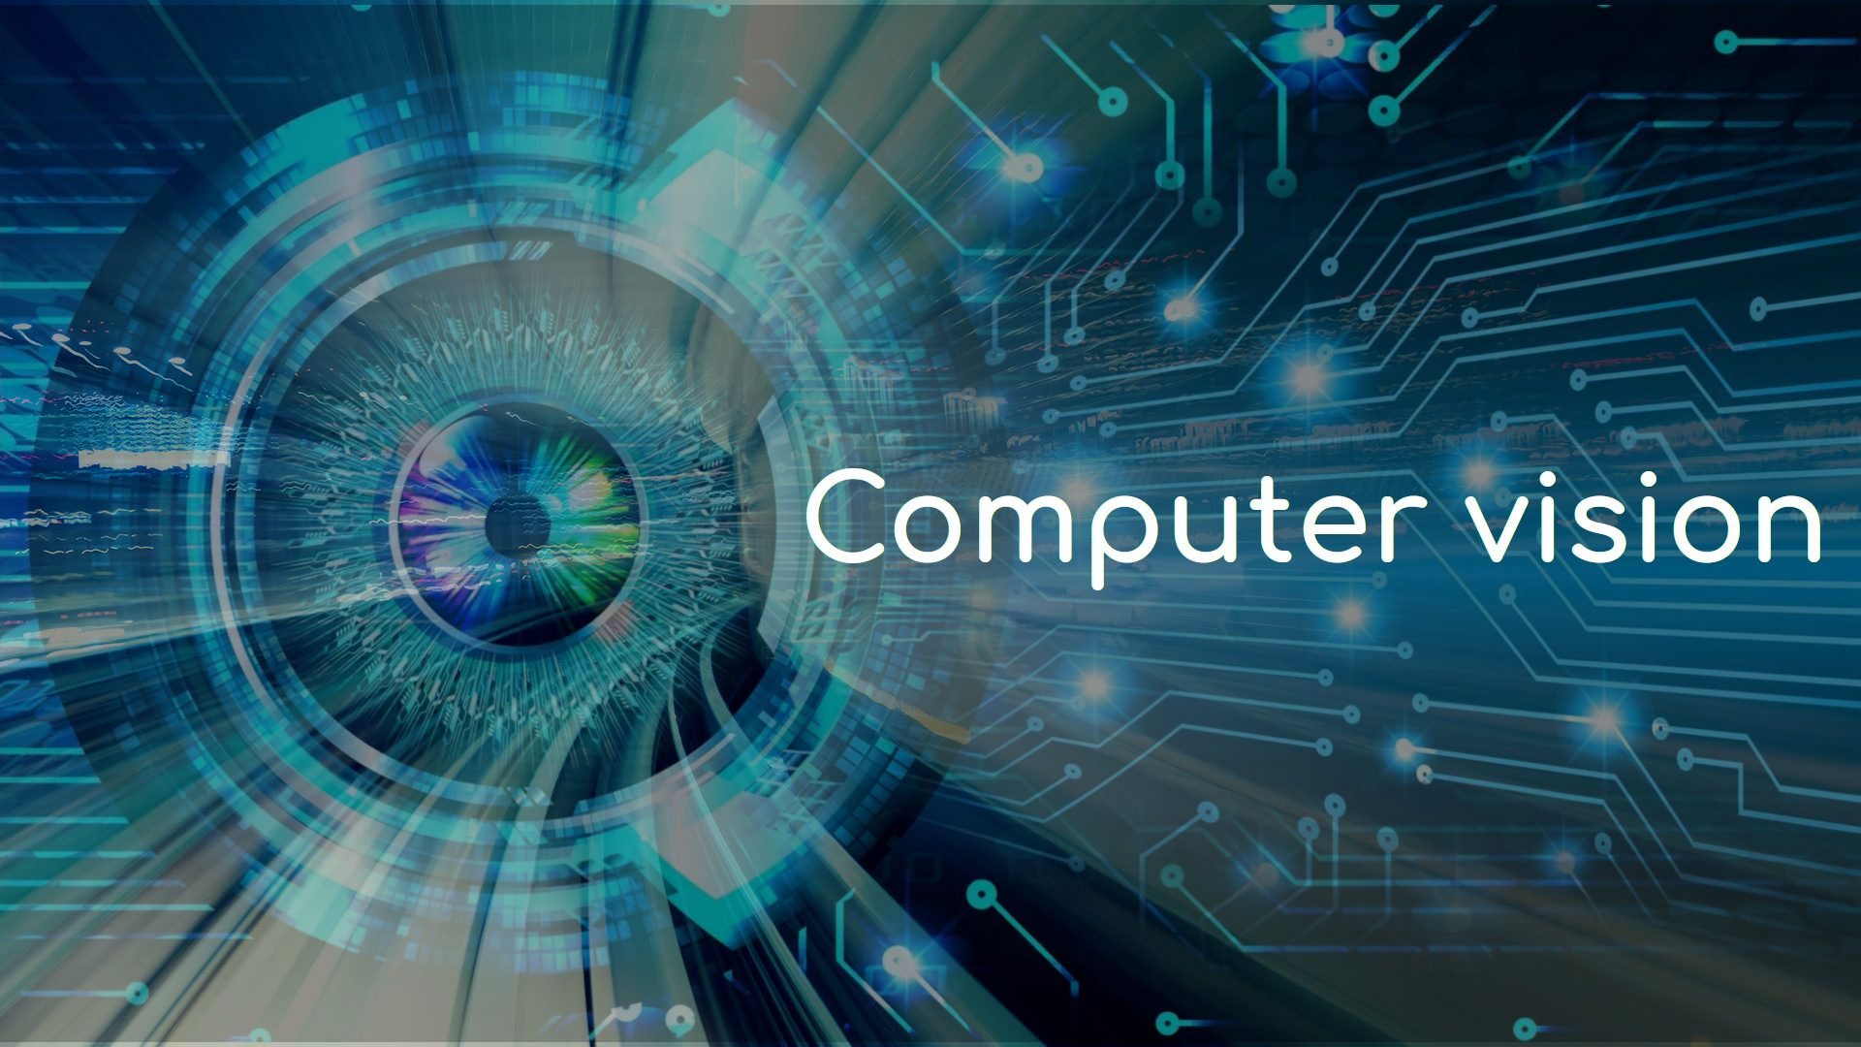

Slide 19
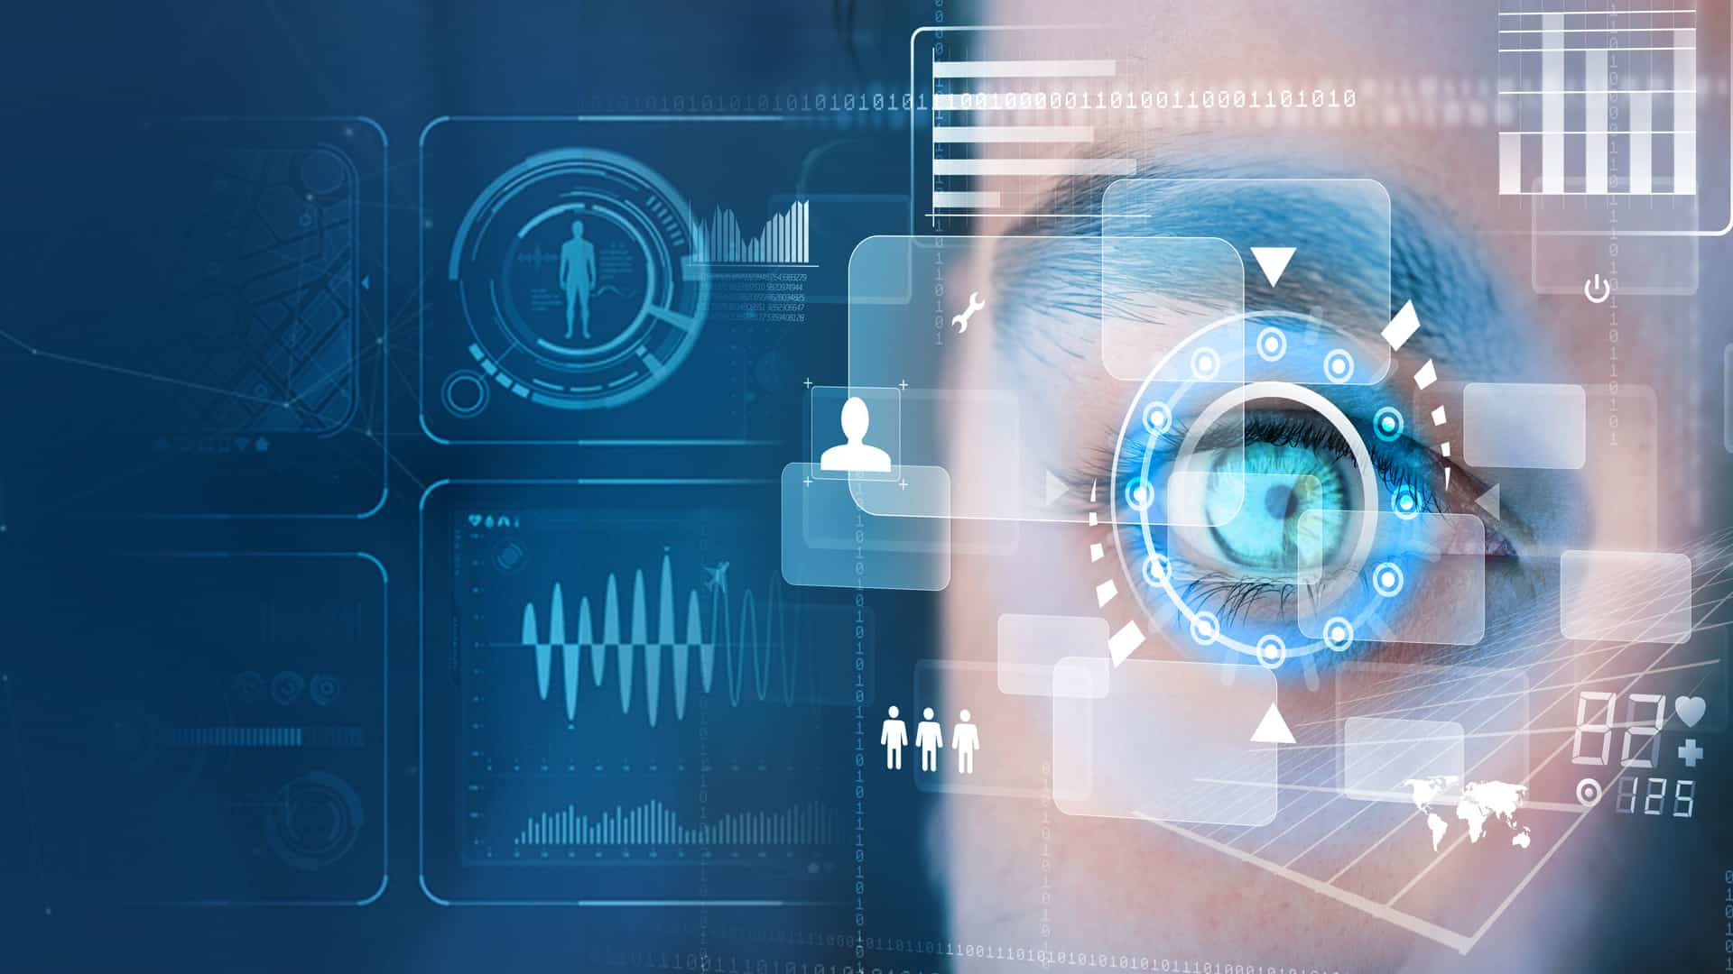
OpenCV:
OpenCV (Open source computer vision) is a library of programming functions mainly aimed at real-time computer vision.
OpenCV-Python:
OpenCV-Python is a library of Python bindings designed to solve computer vision problems.OpenCV-Python makes use of Numpy, which is a highly optimized library for numerical operations with a MATLAB-style syntax. All the OpenCV array structures are converted to and from Numpy arrays. This also makes it easier to integrate with other libraries that use Numpy such as SciPy and Matplotlib.

Slide 20
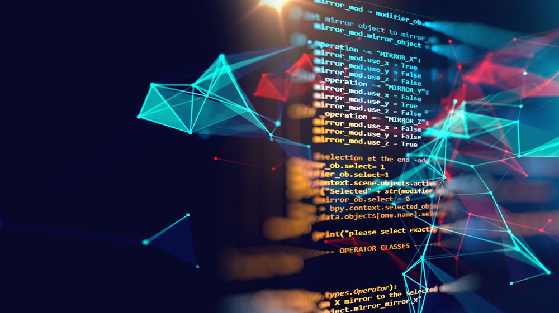
WORKFLOW

Slide 21
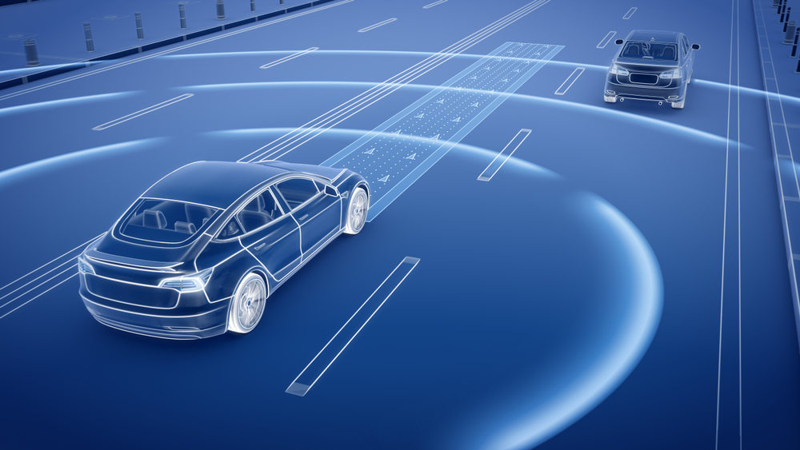
Lane Detection
the video is captured and read frame by frame
Apply Canny Edge Detection to find the all the edges in the image
Find the region of interest in the image
Apply Hough Transform to find straight lines
Find the average sloped lines on the left and right and weighted add it with the original image

Slide 22
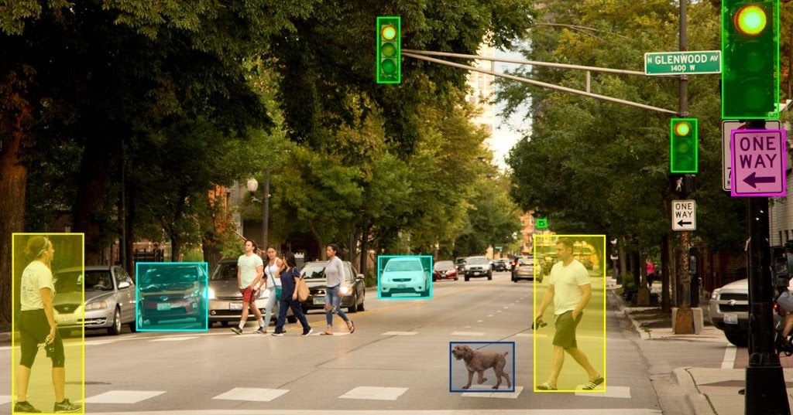
Object Detection
* Load YOLO to load model from the disk and Pass the image through the network and obtain classification
* Using OpenCV, the video is captured and read frame by frame
* Perform Mean Subtraction and scaling using dnn.blobFromImage()
* Get Box Dimensions for the objects.
* Draw labels around the identified objects using Non Maximum Suppression.

Slide 23
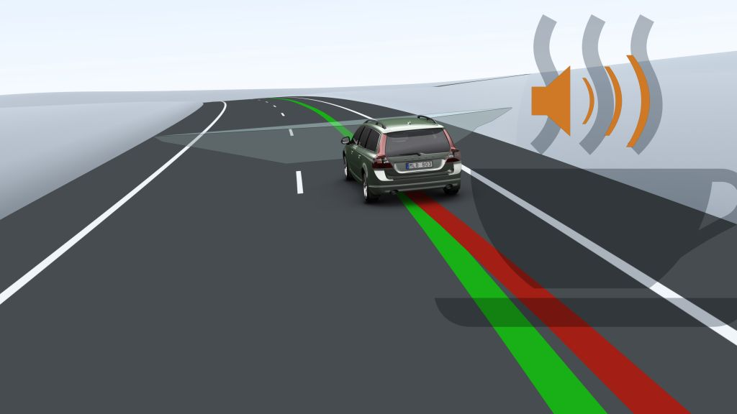
Alert Message
# Pre-set messages using Google Text To Speech(gTTS) API.
# Message during lane changing.
# Over-taking assistance message

Slide 24
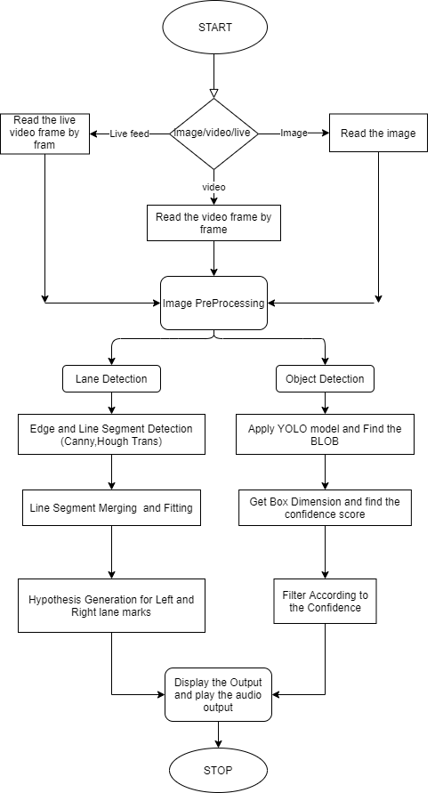
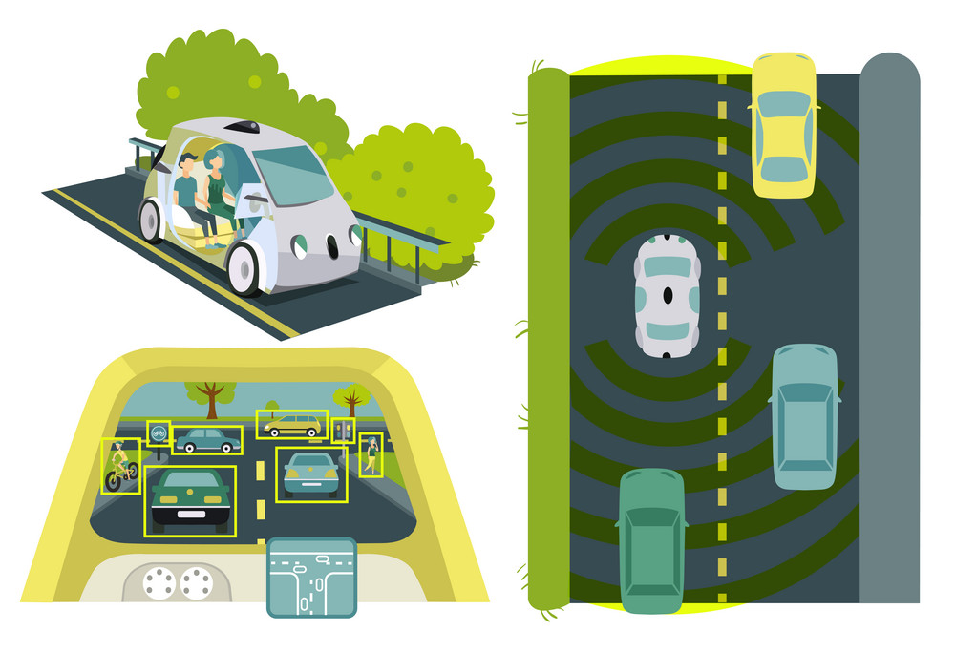

Slide 25

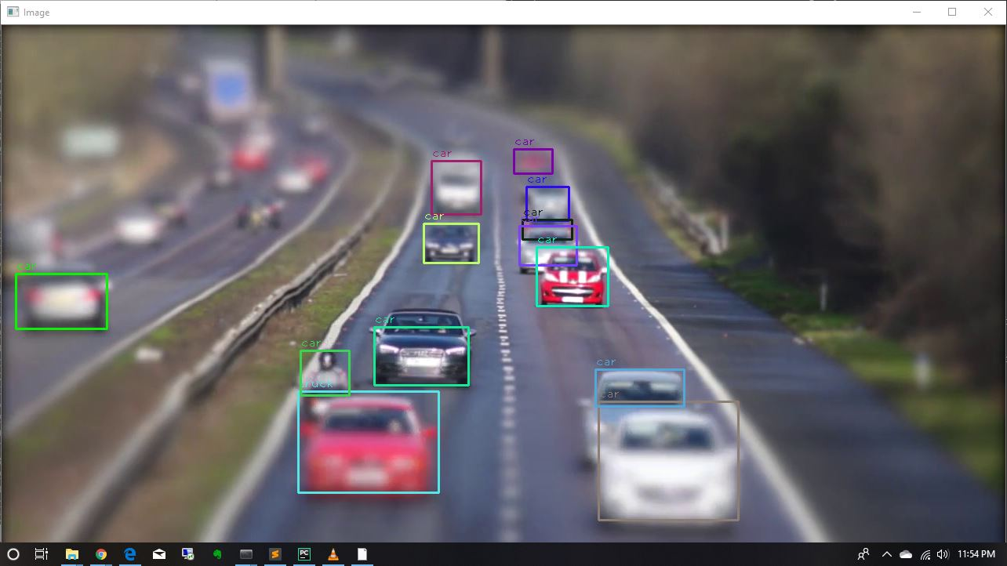
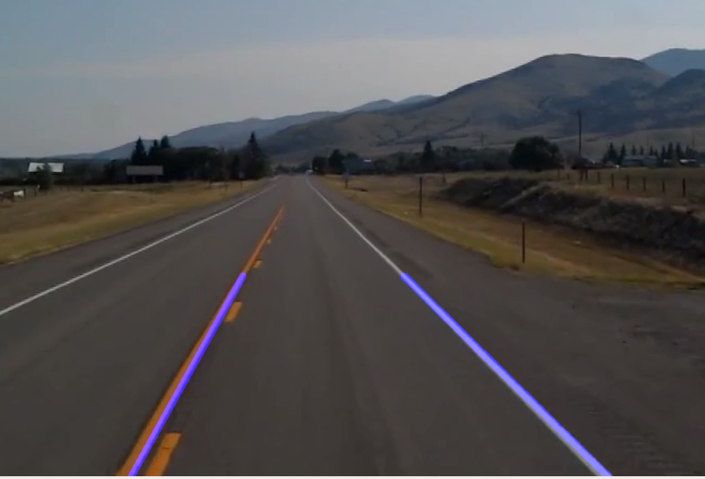
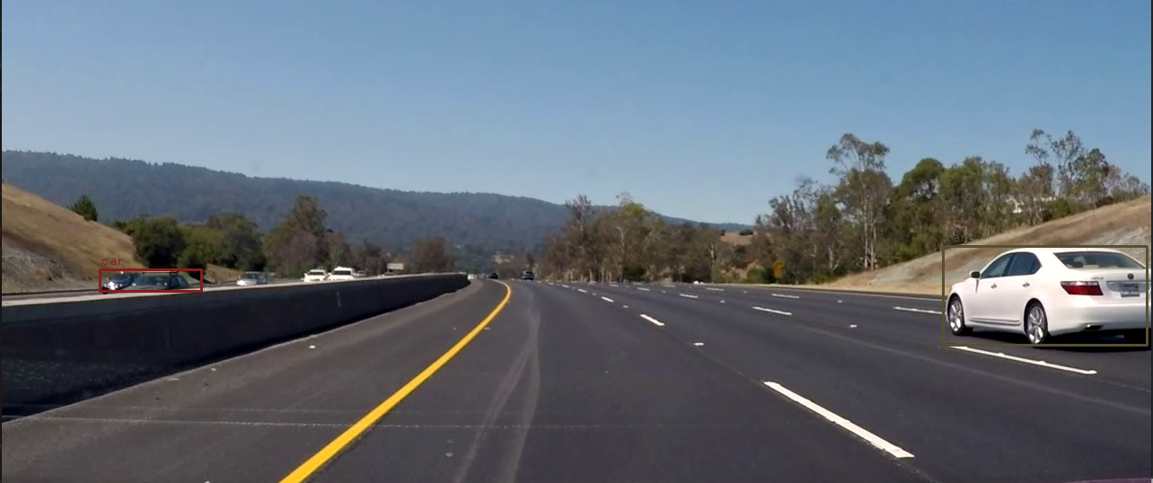

Lane detection
Object Detection

Slide 26
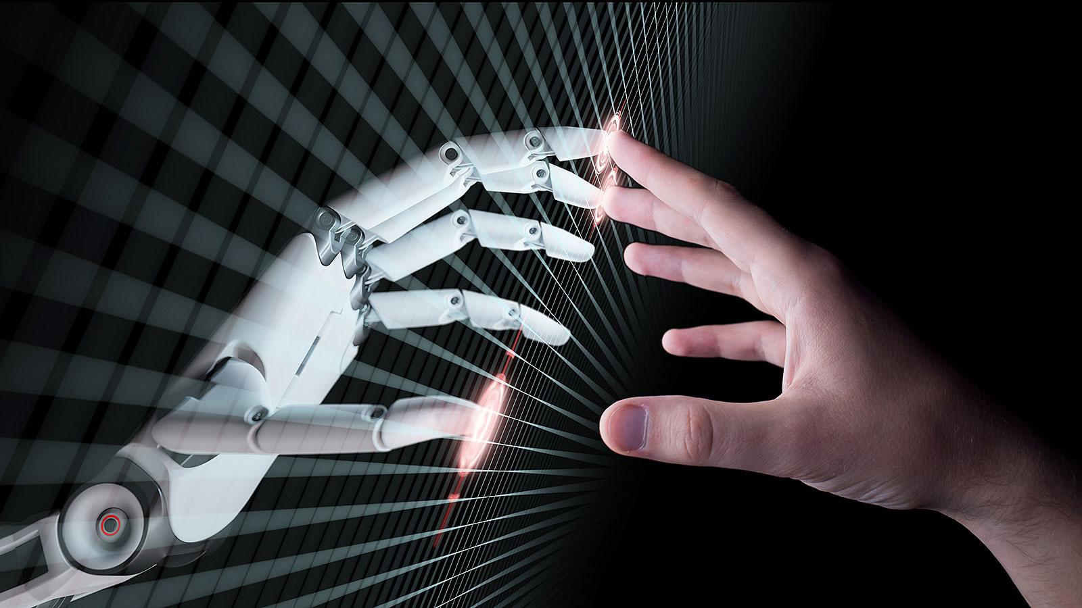
Future Scope

Slide 27
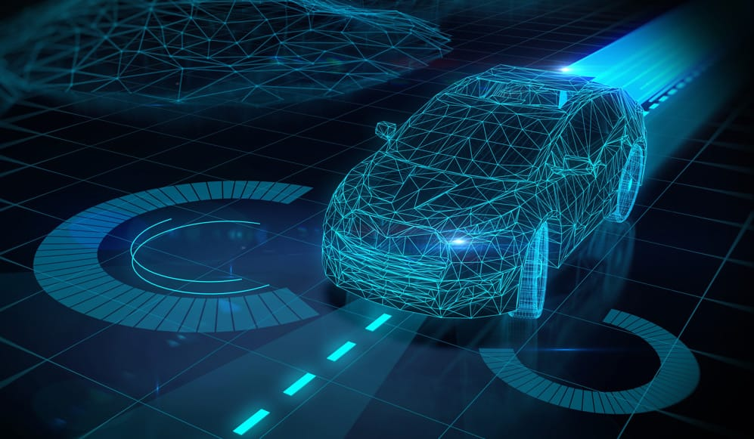
We need to further improve the model so, that it can function properly and efficiently during night time.
We also need to improve the model so that we can extend the functionality to lanes without lane lines.
This model also needs to further improve by making a better vehicle detection system that can identify vehicles that are specific to certain countries (eg. auto rickshaws and thelas in India).

Slide 28
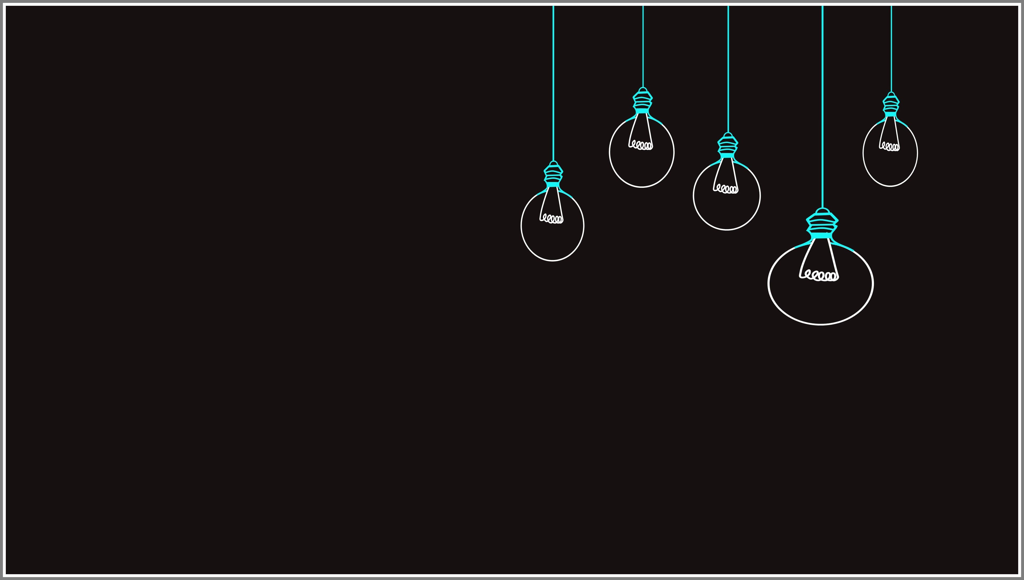
References
[1] Large-Scale Naturalistic Driving Study of Driver Behavior and Interactionwith Automation",MIT Advanced Vehicle Technology Study.IEEE Access,vol. 7, pp. 102021-102038, 2019
[2] Abhishek Shriram Umachigi ,"Human Computer Interaction (HMI) in autonomous vehicles for alerting driver during overtaking and lane changing."
Department of Electrical Engineering , Michigan Technological University.
[3] Allam Shehata Hassanein , Sherien Mohammad, Mohamed Sameer, and Mohammad Ehab Ragab,"A Survey on Hough Transform, Theory, Techniques and Applications",IJCSI International Journal of Computer Science Issues, Volume 12, Issue 1, No 2, January 2015.

Slide 29
[4] Seong-Woo Kim, Baoxing Qin, Zhuang Jie Chong, Xiaotong Shen, Wei Liu,Marcelo H. Ang, Emilio Frazzoli, Daniela Rus, "Multivehicle Cooperative Driving Using Cooperative Perception: Design and Experimental Validation", IEEE Transactions on Intelligent Transportation Systems ( Volume: 16 , Issue: 2 , April 2015 ).
[5] Joseph Redmon, Santosh Divvala, Ross Girshick, Ali Farhadi,"You Only Look Once: Unied, Real-Time Object Detection",2016 IEEE Conference on Computer Vision and Pattern Recognition (CVPR)
[6] Estev~ao S. Gedraite, Murielle Hadad, "Investigation on the eect of a Gaussian Blur in image ltering and segmentation", Proceedings ELMAR-2011.

Slide 30

THANK YOU!

